Slide 1
UNIT 6
Lecture 32
Gross National Happiness
Learning Outcomes
To Understand the concept of personal strengths
To apply laws of positive psychology in real life situation.

Slide 2



Bhutan
is the only country in the world to systematically measure GNH at present.

Slide 3
It turns out that this belief—that happiness is difficult to measure—isn’t really valid.
Although people do vary in what makes them happy, happiness means more-or-less the same thing to most people.
This is why the easiest way to measure happiness—through self-reports in which people are simply asked to fill out a happiness scale—correlates significantly with the levels of neurotransmitters (like serotonin) in our blood stream.
Notes:
https://isb.au1.qualtrics.com/jfe/form/SV_23TdZGYzQsfMeYB?user_id=%25USER_ID%25&Q_JFE=qdg

Slide 4
CLASSROOM HAPPINESS:
Why focus on positive education ?
According to Seligman, Positive Education is a response to the gap between what people want for their children and what schools teach.
Positive education is the combination of traditional education principles with the study of happiness and well-being, using Martin Seligman ‘s PERMA model and the Values in Action (VIA) classification
Most parents want their children to be happy, healthy, and confident, but schools only focus on achievement, discipline, and academic skills. These are of course important, but so are positive mental health outcomes.
To fix this gap, Positive Education is proposed, where schools teach achievement and accomplishment along with positive psychology-informed mental health skills.
In other words, positive education wants to bring positive psychology’s goals of well-being and mental health support for everyone into the school setting.

Slide 5
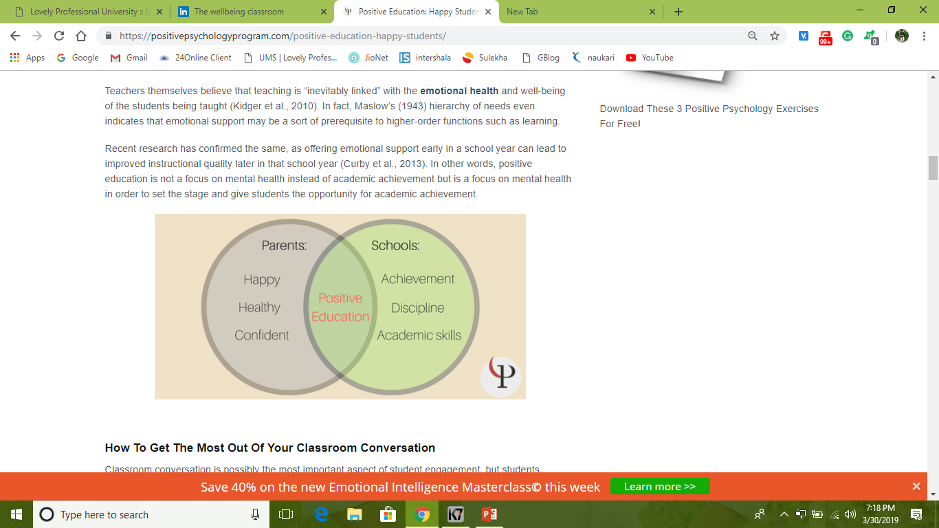
Teachers themselves believe that teaching is “inevitably linked” with the emotional health and well-being of the students being taught.

Slide 6
How To Get The Most Out Of Your Classroom Conversation ??
Classroom conversation is possibly the most important aspect of student engagement, but students participate at various levels with most classrooms being dominated by the same voices each class period.
One way to increase classroom conversation and discussion in a reading-based class is the QQTP approach (Connor-Greene, 2005).

Slide 7
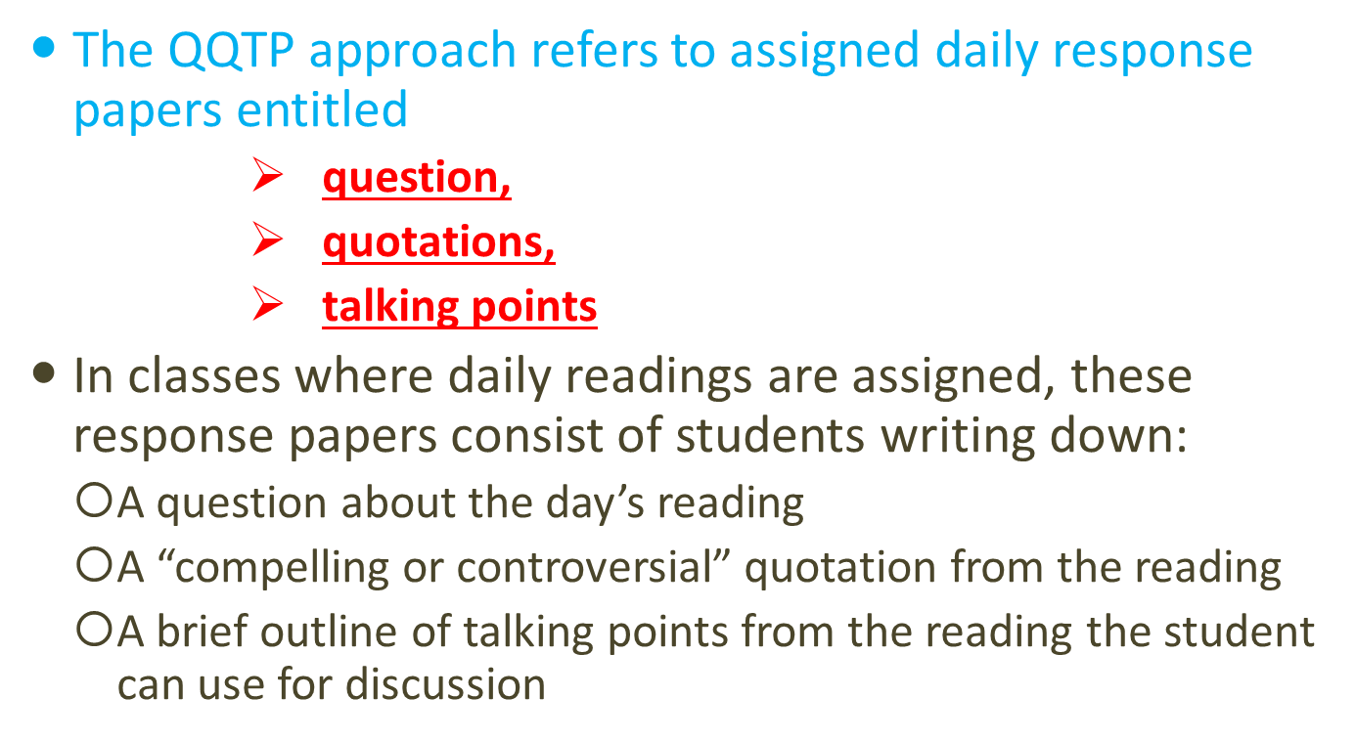

Slide 8
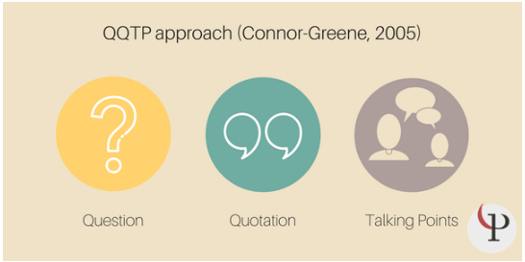

Slide 9
Another way to increase student discussion is to offer participation credit.
Grading based on participation, however, can be disadvantageous to students who are more naturally shy.
One solution to this is to offer group participation credit.
Some researchers found increased participation levels in low-participating students with this group-based credit system.
This method also had the added bonus of high-participating students teaching low-participating students how to participate more often, so that the group would receive their shared credit.

Slide 10
Lets Check!!!
Which is the only country in the world to systematically measure GNH at present?
Who started the positive education?
Positive education is the combination of traditional education principles with the study of happiness and well-being, using Martin Seligman ‘s _____ model and the ___________ classification.
______________is a response to the gap between what people want for their children and what schools teach.
What do you mean by participation credit?
How can group participation credit be helpful?
What is the full form of approach QQTP?

